Slide 1
Introduction to machine learning and Cluster Analysis
By- Dr. Amit Rathi, Dept of CSE, JUET, Guna

Slide 2
Machine Learning
Machine learning (ML) is a subset of artificial intelligence (AI) that involves developing algorithms and statistical models that enable computers to learn from and make predictions or decisions based on data.
The goal of machine learning is to automatically learn patterns and relationships from data without explicit programming.

Slide 3
Machine Learning
Key Concepts in Machine Learning:
Supervised Learning:
  In supervised learning, the algorithm learns from labeled data, where each data point is associated with a known outcome (or target variable).
  Examples: Classification (predicting categories), Regression (predicting continuous values).
Unsupervised Learning:
  In unsupervised learning, the algorithm learns patterns from unlabeled data, discovering hidden structures or relationships in the data.
  Examples: Clustering (grouping similar data points), Dimensionality Reduction (reducing the number of variables).
Reinforcement Learning:
  Reinforcement learning involves an agent learning to make decisions in an environment to maximize cumulative reward.
  Examples: Game playing, robotics, autonomous driving.

Slide 4
Machine Learning
Types of Algorithms:
Linear Regression, Logistic Regression: Simple models for regression and classification tasks.
Decision Trees, Random Forests: Tree-based models that partition the data into hierarchical structures.
Support Vector Machines (SVM): Effective for classification tasks by finding hyperplanes in high-dimensional space.
Neural Networks: Deep learning models with multiple layers, capable of learning complex patterns.

Slide 5
Machine Learning
Model Evaluation:
Metrics like accuracy, precision, recall, F1-score for classification.
Mean Squared Error (MSE), R-squared for regression.
Cross-validation to assess model performance.
Applications:
Natural Language Processing (NLP): Text analysis, sentiment analysis, language translation.
Computer Vision: Image recognition, object detection, facial recognition.
Recommendation Systems: Personalized recommendations in e-commerce, streaming platforms.
Healthcare: Diagnostics, personalized medicine.
Finance: Fraud detection, risk assessment.

Slide 6
Machine Learning
Model Evaluation:
Metrics like accuracy, precision, recall, F1-score for classification.
Mean Squared Error (MSE), R-squared for regression.
Cross-validation to assess model performance.
Applications:
Natural Language Processing (NLP): Text analysis, sentiment analysis, language translation.
Computer Vision: Image recognition, object detection, facial recognition.
Recommendation Systems: Personalized recommendations in e-commerce, streaming platforms.
Healthcare: Diagnostics, personalized medicine.
Finance: Fraud detection, risk assessment.

Slide 7
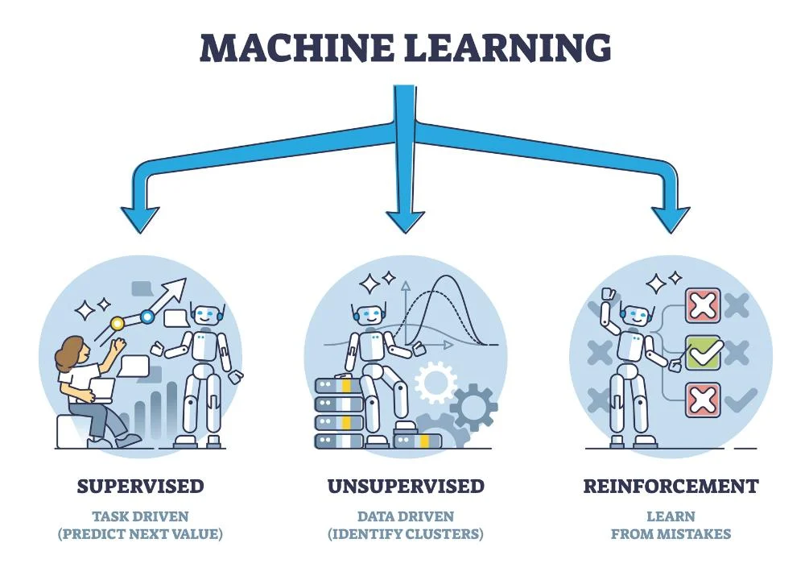

Slide 8
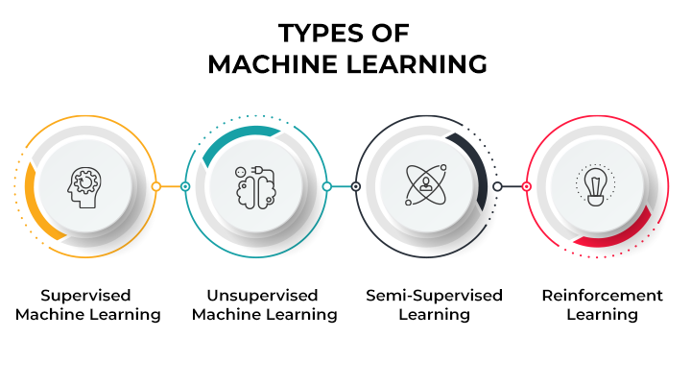

Slide 9
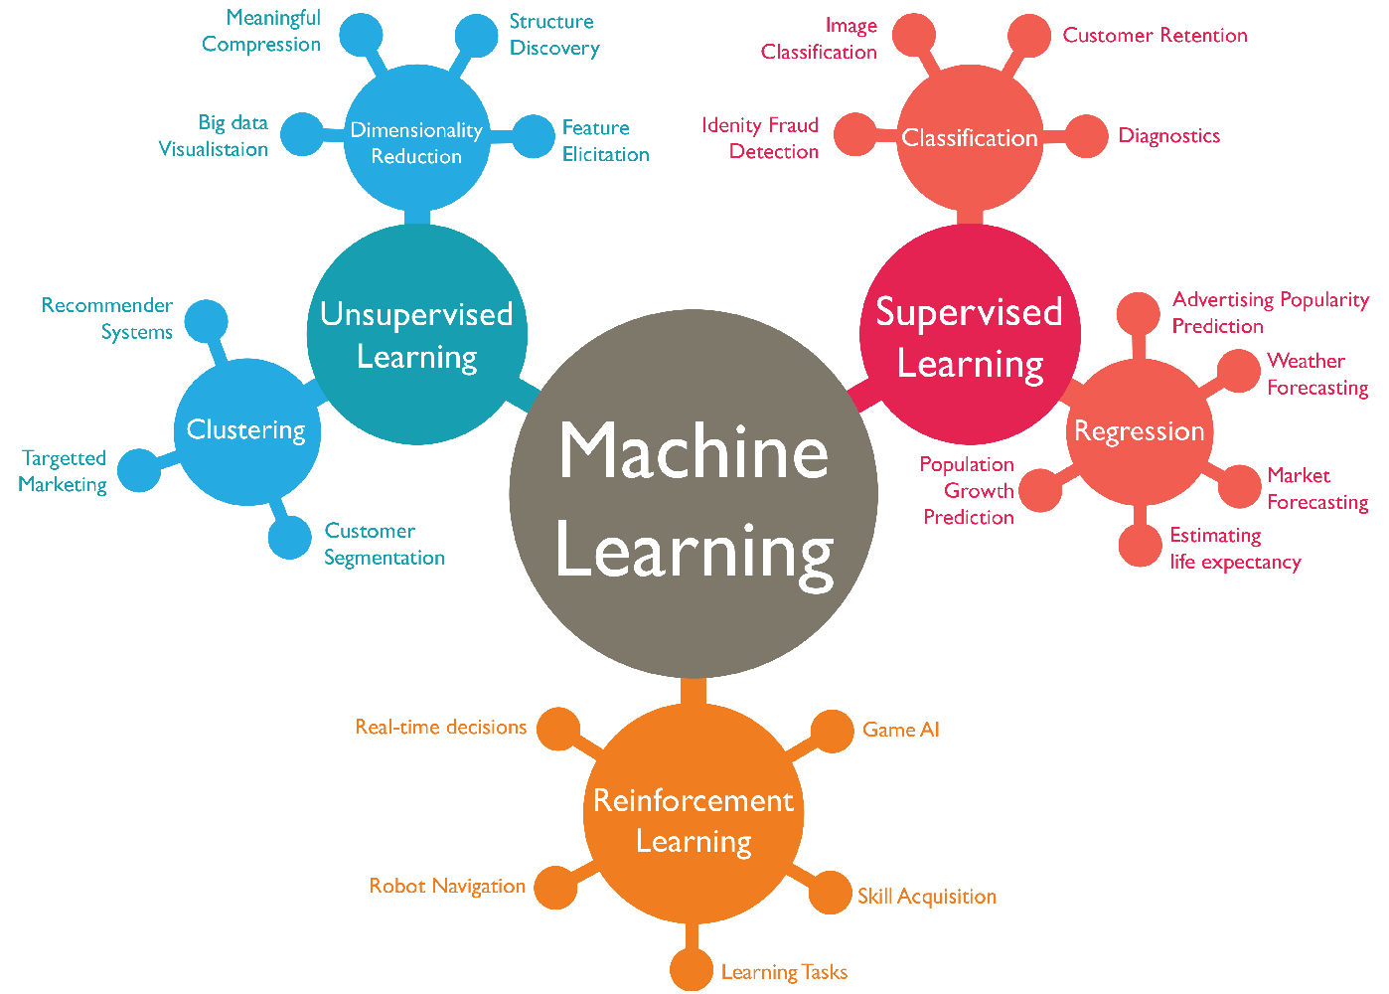

Slide 10
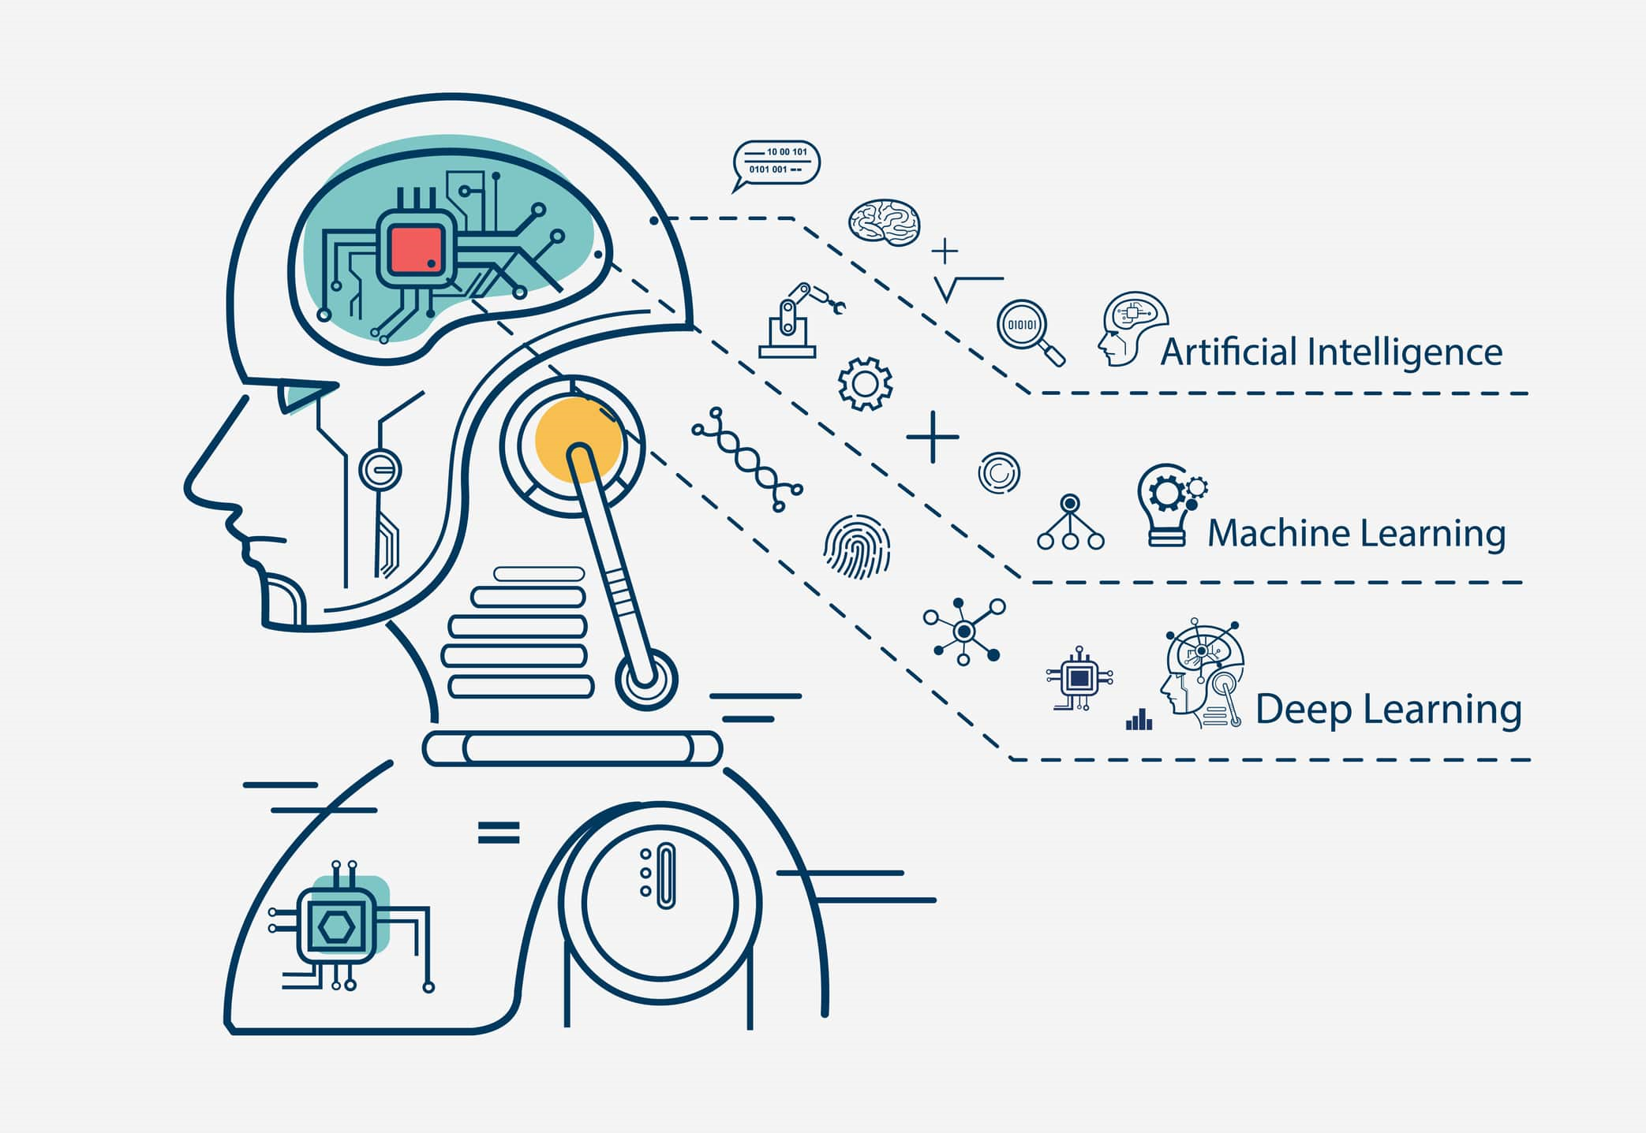

Slide 11
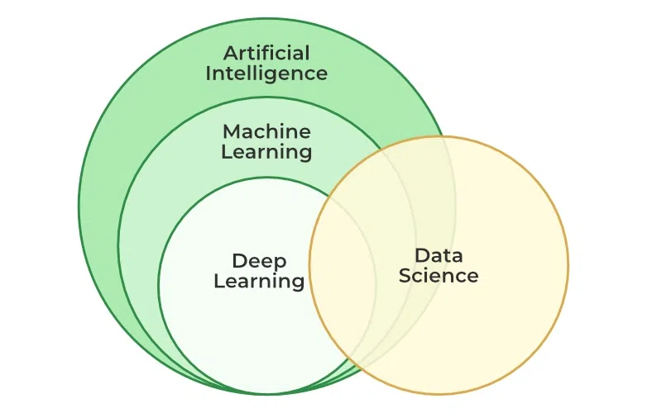

Slide 12
Cluster Analysis
Cluster analysis is a technique used in unsupervised learning to group a set of objects (data points) in such a way that objects in the same group (cluster) are more similar to each other than to those in other groups.
It is widely used for exploring data, identifying patterns, and segmenting data into meaningful groups.

Slide 13
Cluster Analysis
Types of Cluster Analysis:
Hierarchical Clustering:
  Builds a hierarchy of clusters, either agglomerative (bottom-up) or divisive (top-down).
  Agglomerative: Starts with individual data points as clusters and merges them based on similarity.
  Divisive: Starts with one cluster and splits it recursively.
Partitioning Methods:
  Divides data into non-overlapping clusters.
  Examples: K-means clustering, Gaussian Mixture Models (GMM).
Density-Based Methods:
  Clusters data points based on density.
  Example: DBSCAN (Density-Based Spatial Clustering of Applications with Noise).
Centroid-Based Methods:
  Clusters data points around centroids (cluster centers).
  Example: K-means clustering.

Slide 14
Cluster Analysis
Steps in Cluster Analysis:
Data Preprocessing:
  Handling missing values, scaling features, encoding categorical variables.
Choosing a Clustering Algorithm:
  Based on the nature of data and desired outcome (e.g., number of clusters).
Feature Selection:
  Identifying relevant features for clustering.
Model Training:
  Applying the chosen clustering algorithm to the data.
Evaluation:
  Assessing the quality of clusters using internal (e.g., silhouette score) or external (e.g., comparing with known labels) metrics.
Interpretation and Visualization:
  Understanding the characteristics of each cluster and interpreting results.

Slide 15
Cluster Analysis
Applications of Cluster Analysis:
Customer Segmentation: Grouping customers based on purchasing behavior.
Market Segmentation: Segmenting markets based on demographics, behavior.
Image Segmentation: Partitioning an image into meaningful regions.
Anomaly Detection: Identifying outliers or unusual patterns in data.
Document Clustering: Grouping similar documents together in text mining.

Slide 16
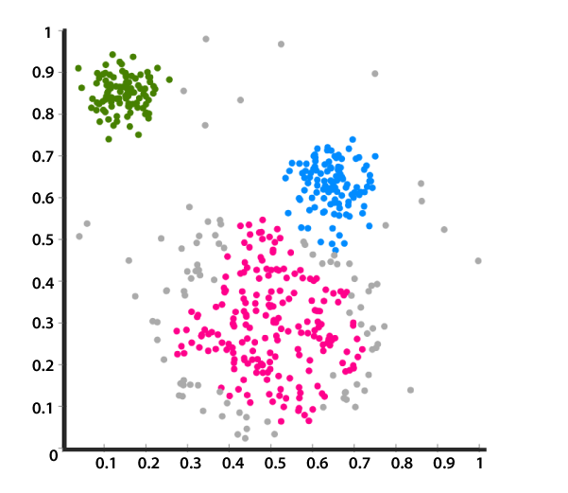

Slide 17
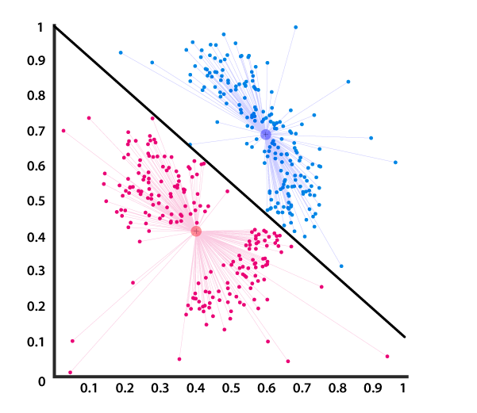

Slide 18
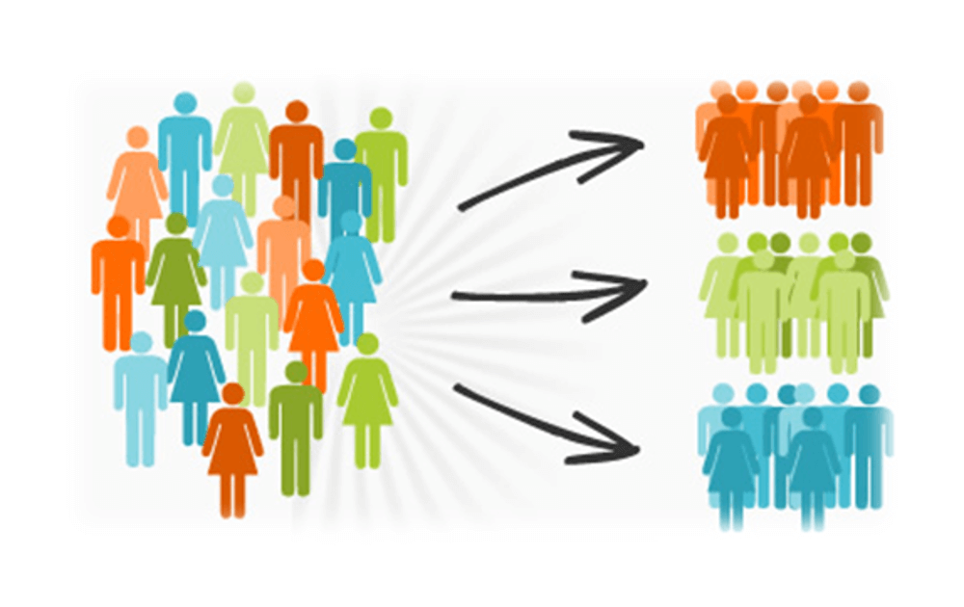

Slide 19
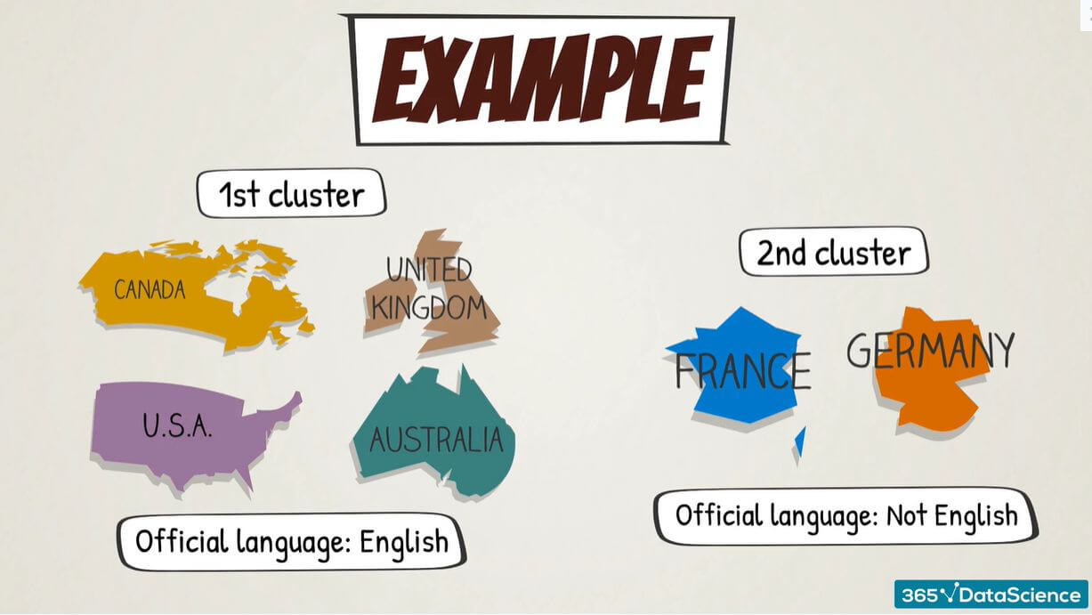

Slide 20
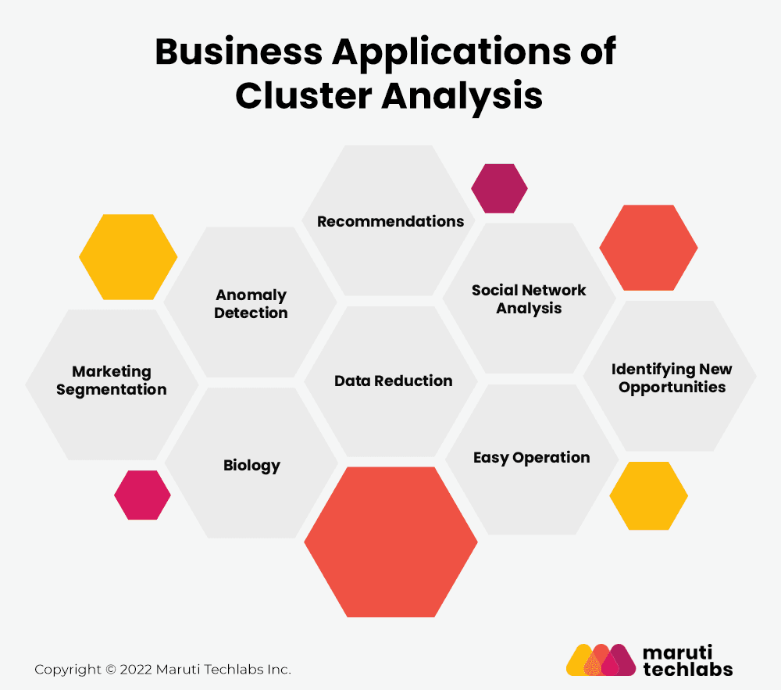

Slide 21
Methods of Supervised Learning
In supervised learning, the model is trained on labeled data, meaning each training example has a corresponding label or output. The goal is to learn a mapping from inputs to outputs that can be generalized to new, unseen data. Here are some common methods:
Linear Regression:
  Objective: Predict a continuous target variable.
  Example: Predicting house prices based on features like size, location, and number of bedrooms.

Slide 22
Methods of Supervised Learning
Logistic Regression:
  Objective: Classify data into binary categories.
  Example: Determining if an email is spam or not spam.
Decision Trees:
  Objective: Make decisions based on feature values.
  Example: Classifying whether a customer will buy a product based on their age and income.

Slide 23
Methods of Supervised Learning
Random Forests:
  Objective: Improve decision tree performance by averaging multiple trees.
  Example: Predicting stock market trends based on historical data.
Support Vector Machines (SVM):
  Objective: Find the optimal hyperplane that separates different classes.
  Example: Classifying images of cats vs. dogs.

Slide 24
Methods of Supervised Learning
K-Nearest Neighbors (KNN):
  Objective: Classify data based on the majority label of the nearest neighbors.
  Example: Recommending products based on user preferences.
Neural Networks:
  Objective: Model complex patterns through layers of interconnected nodes.
  Example: Image recognition, natural language processing.

Slide 25
Methods of Supervised Learning
Gradient Boosting Machines (GBM):
  Objective: Build models sequentially to correct errors of previous models.
  Example: Predicting loan defaults based on customer data.

Slide 26
Methods of Unsupervised Learning
In unsupervised learning, the model is trained on data without labeled responses. The goal is to identify patterns, groupings, or structures within the data. Here are some common methods:
Clustering:
  K-Means Clustering:
    Objective: Partition data into K distinct clusters.
    Example: Grouping customers into segments for targeted marketing.
  Hierarchical Clustering:
    Objective: Build a hierarchy of clusters.
    Example: Creating a dendrogram to show relationships between various species.

Slide 27
Methods of Unsupervised Learning
Dimensionality Reduction:
  Principal Component Analysis (PCA):
    Objective: Reduce the number of features while retaining most of the variance in the data.
    Example: Visualizing high-dimensional data in 2D or 3D.
  t-Distributed Stochastic Neighbor Embedding (t-SNE):
    Objective: Reduce dimensionality for visualization, focusing on preserving local data structure.
    Example: Visualizing clusters in high-dimensional datasets.

Slide 28
Methods of Unsupervised Learning
Association Rule Learning:
  Apriori Algorithm:
    Objective: Find frequent itemsets and generate association rules.
    Example: Market basket analysis to discover product purchase patterns.
  Eclat Algorithm:
    Objective: Find frequent itemsets using a depth-first search strategy.
    Example: Identifying co-purchased products in a retail store.

Slide 29
Methods of Unsupervised Learning
Anomaly Detection:
  Isolation Forest:
    Objective: Identify outliers by isolating them in the feature space.
    Example: Fraud detection in financial transactions.
  One-Class SVM:
    Objective: Model the distribution of normal data to identify anomalies.
    Example: Intrusion detection in network security.
Autoencoders:
  Objective: Learn a compressed representation of data by encoding and decoding it.
  Example: Denoising images or reducing dimensionality.

Slide 30
Methods of Unsupervised Learning
Generative Adversarial Networks (GANs):
  Objective: Generate new data samples similar to the training data by training two networks (generator and discriminator) in opposition.
  Example: Creating realistic images or enhancing image resolution.
Each of these methods has its own strengths and weaknesses, and the choice of method depends on the specific problem, data characteristics, and objectives.

